Slide 1
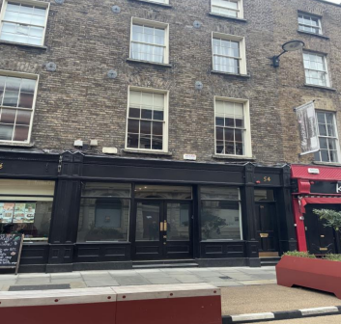
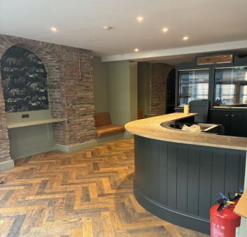
54 Capel St, North City, Dublin 1
54 Capel St, North City, Dublin 1
To let
Property Highlights
      Excellent cafe / restaurant opportunity on Capel street Dublin 1.
      54 Capel Street is ideally located near Jervis shopping centre and is
      well served by numerous Dublin Bus and Luas routes .
      Extending to approx. 245 sqm (2,638 sqft).
      Terrace area – 34.7 sqm (373 sqft).
Property description
54 Capel Street comprises a bar premises arranged over ground and basement levels, with extensive outdoor space to the rear. The property provides an overall internal floor area of approximately 245.1 sq m (2,638 sq ft), together with a substantial rear yard offering significant potential for outdoor seating or events.
• The ground floor features an open-plan bar layout with a traditional frontage onto Capel Street, while the basement provides ancillary storage and staff accommodation. The property benefits from rear access, allowing for convenient deliveries and operational flexibility.
• This is a rare opportunity to secure a vacant, fully self-contained bar premises in one of Dublins most vibrant and well-established city centre locations.
Contact
Conor Niland
Email: Conor.Niland@cushwake.com
Tel: +353 1 639 9219
Max Harrington
Email: Max.Harrington@cushwake.com
Tel: +353 86 817 3854

Slide 2
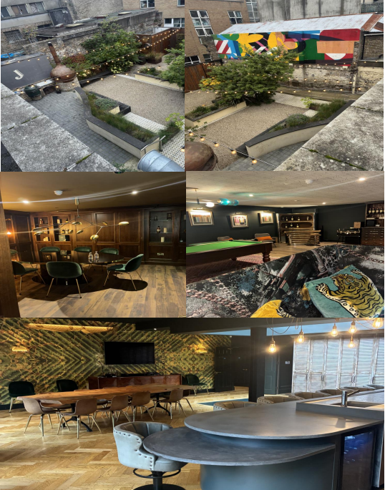
54 Capel St, North City, Dublin 1

Slide 3
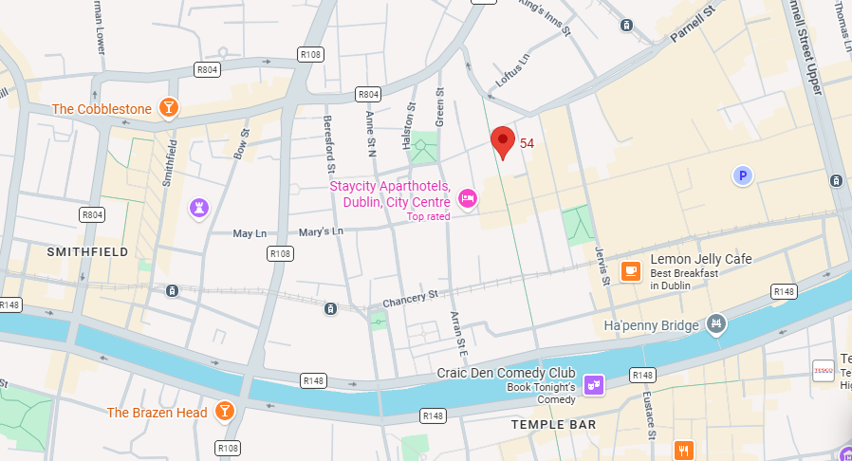
54 Capel St, North City, Dublin 1
The property occupies a prominent position on Capel street, one of Dublin’s most distinctive and vibrant city centre streets. Now leading hospitality and leisure destination, Capel Street offers a diverse mix of bars, cafes and independent retailers with strong daily footfall.
Ideally located close to Jervis Shopping Centre, the property benefits from excellent public transport links via Dublin Bus and Luas, and I s within walking distance of Henry Street, Smithfield and O’Connel Street.
Service Charge
TBC
Viewings
Strictly by appointment only through sole leasing agents Cushman & Wakefield.
Rates
TBC
Insurance
TBC
BER: TBC
Rent
Rent is on application.

